Slide 1
Lab 8: Matrix Multiplication
By Jeremy Lim

Slide 2
Parallelism recap
Suppose you have some operations
Should you parallelise?
Some operation
Some operation
Some operation
Some operation

Slide 3
Parallelism recap
Result of op comes here
Thread lifecycle
Create Thread
Some operation
Destroy Thread
Overhead

Slide 4
Parallelism recap
Multiple threads
Create Thread
Some operation
Destroy Thread
Create Thread
Some operation
Destroy Thread
= save time
Create Thread
Some operation
Destroy Thread
Create Thread
Some operation
Destroy Thread
Some operation
Some operation
Some operation
Some operation

Slide 5
Parallelism recap
Multiple threads
Create Thread
Some operation
Destroy Thread
Create Thread
Some operation
Destroy Thread
= waste time
Create Thread
Some operation
Destroy Thread
Create Thread
Some operation
Destroy Thread
Some operation
Some operation
Some operation
Some operation

Slide 6

Parallelism recap
When can an operation NOT be parallelised?
When the order of inputs matter
i.e. the operation is associative, e.g. $\left(2a+b\right)$
When the order of execution matters
i.e. the operation is stateful

Slide 7
I’m so lost
Simple no parallel
Take long long parallel
Got order no parallel

Slide 8

Matrix multiplication
$\left[\begin{matrix}c_{11} & c_{12} \\ c_{21} & c_{22}\end{matrix}\right]=\left[\begin{matrix}a_{11} & a_{12} \\ a_{21} & a_{22}\end{matrix}\right]∙\left[\begin{matrix}b_{11} & b_{12} \\ b_{21} & b_{22}\end{matrix}\right]$
$c_{ij}=\sum_{k=1}^{n}{\left(a_{ik}×b_{kj}\right)}$
$c_{11}=a_{11}b_{11}+a_{12}b_{21}$

Slide 9
Matrix multiplication
$\left[\begin{matrix}c_{11} & c_{12} \\ c_{21} & c_{22}\end{matrix}\right]=\left[\begin{matrix}a_{11} & a_{12} \\ a_{21} & a_{22}\end{matrix}\right]∙\left[\begin{matrix}b_{11} & b_{12} \\ b_{21} & b_{22}\end{matrix}\right]$
$c_{ij}=\sum_{k=1}^{n}{\left(a_{ik}×b_{kj}\right)}$
$c_{11}=a_{11}b_{11}+a_{12}b_{21}$

Slide 10
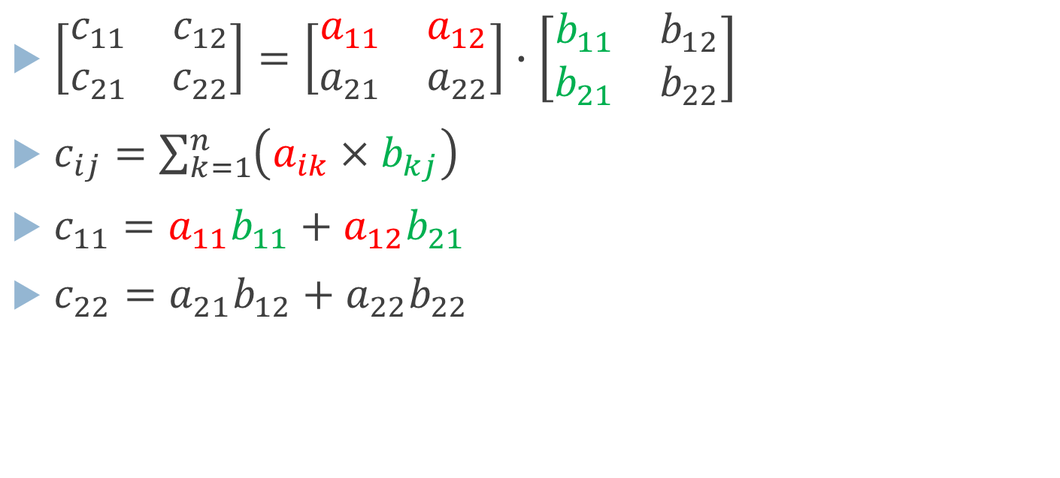
Matrix multiplication
$\left[\begin{matrix}c_{11} & c_{12} \\ c_{21} & c_{22}\end{matrix}\right]=\left[\begin{matrix}a_{11} & a_{12} \\ a_{21} & a_{22}\end{matrix}\right]∙\left[\begin{matrix}b_{11} & b_{12} \\ b_{21} & b_{22}\end{matrix}\right]$
$c_{ij}=\sum_{k=1}^{n}{\left(a_{ik}×b_{kj}\right)}$
$c_{11}=a_{11}b_{11}+a_{12}b_{21}$
$c_{22}=a_{21}b_{12}+a_{22}b_{22}$

Slide 11


Parallelisation
Individual cell non-recursive
result
a
b
$$=$$
$$∙$$

Slide 12
Parallelisation
Individual cell non-recursive
result
a
b
$$=$$
$$∙$$

Slide 13
Parallelisation
Individual cell non-recursive
result
a
b
$$=$$
$$∙$$

Slide 14
Parallelisation
Individual cell non-recursive
result
a
b
$$=$$
$$∙$$

Slide 15
Parallelisation
Individual cell non-recursive
result
a
b
…
$$=$$
$$∙$$

Slide 16
Parallelisation
Individual cell recursive
result
a
b
$$=$$
$$∙$$

Slide 17
Parallelisation
Individual cell recursive
result
a
b
$$=$$
$$∙$$

Slide 18
Parallelisation
Individual cell recursive
result
a
b
$$=$$
$$∙$$

Slide 19
Parallelisation
Individual cell recursive
result
a
b
$$=$$
$$∙$$

Slide 20
Parallelisation
Individual cell recursive
result
a
b
…
$$=$$
$$∙$$

Slide 21
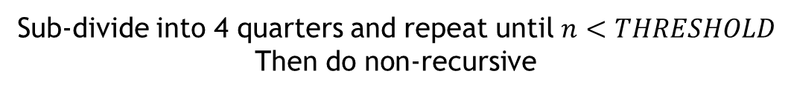
Parallelisation
Individual cell recursive
result
a
b
n
$$=$$
$$∙$$
Sub-divide into 4 quarters and repeat until $n<THRESHOLD$
Then do non-recursive

Slide 22
Parallelisation
Individual cell recursive
result
a
b
n
$$=$$
$$∙$$
Sub-divide into 4 quarters and repeat until $n<THRESHOLD$
Then do non-recursive

Slide 23
Parallelisation
Individual cell recursive
result
a
b
“What’s the point? There won’t be any speedup”
n
$$=$$
$$∙$$
Sub-divide into 4 quarters and repeat until $n<THRESHOLD$
Then do non-recursive

Slide 24
Parallelisation
Individual cell recursive
result
a
b
“What’s the point? There won’t be any speedup”
n
Correct. It’s for you to copy code smartly ☺
$$=$$
$$∙$$
Sub-divide into 4 quarters and repeat until $n<THRESHOLD$
Then do non-recursive

Slide 25

Parallelisation
Parallel
result
a
b
n
$$=$$
$$∙$$
Sub-divide into 4 quarters and repeat until $n<FORK_THRESHOLD$
Then do non-recursive

Slide 26
FAQ
(Not really but if you’re asking these questions you’re doing good)

Slide 27

Parallelisation
FAQ: Must I make 4 $\left(\frac{n}{4}×\frac{n}{4}\right)$ matrices and combine them together?
No.
result
a
b
$$=$$
$$∙$$

Slide 28
Parallelisation
FAQ: Can 2 threads use the same array at once?
result
a
b
$$=$$
$$∙$$

Slide 29
Parallelisation
FAQ: Can 2 threads use the same array at once?
Yes. As long as the same memory address isn’t written at the same time
result
a
b
write
read
$$=$$
$$∙$$

Slide 30
Parallelisation
(unrelated to the lab)
FAQ: Can 2 threads use the same ArrayList at once?
No. They might write to the same memory location
Use concurrent data structures instead
https://docs.oracle.com/javase/9/docs/api/java/util/concurrent/package-summary.html
Write data
Get memory location
Set next memory location
Some operation
list.add(x)
Some operation
list.add(x)
Get memory location
Set next memory location
Write data

Slide 31
Parallelisation
(unrelated to the lab)
FAQ: Can 2 threads use the same ArrayList at once?
No. They might write to the same memory location
Use concurrent data structures instead
https://docs.oracle.com/javase/9/docs/api/java/util/concurrent/package-summary.html
Write data
Get memory location
Set next memory location
Some operation
list.add(x)
Some operation
list.add(x)
Get memory location
Set next memory location
Write data

Slide 32
Parallelisation
(unrelated to the lab)
FAQ: Can 2 threads use the same ArrayList at once?
No. They might write to the same memory location
Use concurrent data structures instead
https://docs.oracle.com/javase/9/docs/api/java/util/concurrent/package-summary.html
Write data
arr[100]
arr[101]
Get memory location
Set next memory location
Some operation
list.add(x)
Some operation
list.add(x)
Get memory location
Set next memory location
arr[100]
arr[101]
Write data

Slide 33
Parallelisation
(unrelated to the lab)
FAQ: Can 2 threads use the same ArrayList at once?
No. They might write to the same memory location
Use concurrent data structures instead
https://docs.oracle.com/javase/9/docs/api/java/util/concurrent/package-summary.html
Write data
arr[100]
arr[101]
Get memory location
Set next memory location
Some operation
list.add(x)
With concurrent data structure
Some operation
list.add(x)
Get memory location
Set next memory location
arr[101]
arr[102]
Write data

